Slide 1

Predictive Maintenance Report
Multilabel Failure Classification with Machine Learning
AI4I 2020 Predictive Maintenance Dataset · UCI Machine Learning Repository
Danilo Luvizotto Gonçalves
13/03/2026

Slide 2
Table of Contents
01
04
Business Problem
Results & Comparison
Why predictive maintenance matters;
Current state analysis
Logistic Regression vs Random Forest vs XGBoost
02
05
Dataset Overview
Key Insights
AI4I 2020 · 10k samples · 5 failure types
SHAP-based feature importance
03
06
Methodology
Conclusions
Pipeline, class imbalance & CV strategy
Summary & next steps

Slide 3
01 · Business Problem
$50B+
30–40%
~97%
Annual cost of
unplanned downtime
(manufacturing, global)
Cost reduction with
predictive vs. reactive
maintenance
Operational time
is failure-free
(rare event challenge)
The Challenge
Industrial equipment fails in multiple, simultaneous ways. Each failure type (tool wear, heat dissipation, power failure, overstrain, random) requires a distinct maintenance action. Traditional binary alarms miss this granularity — and extreme class imbalance (~1–3% failure rate per type) makes the problem technically demanding.
To maintain business competitivity, our industry need a solution that handles these failures with precision, to minimize costs.

Slide 4
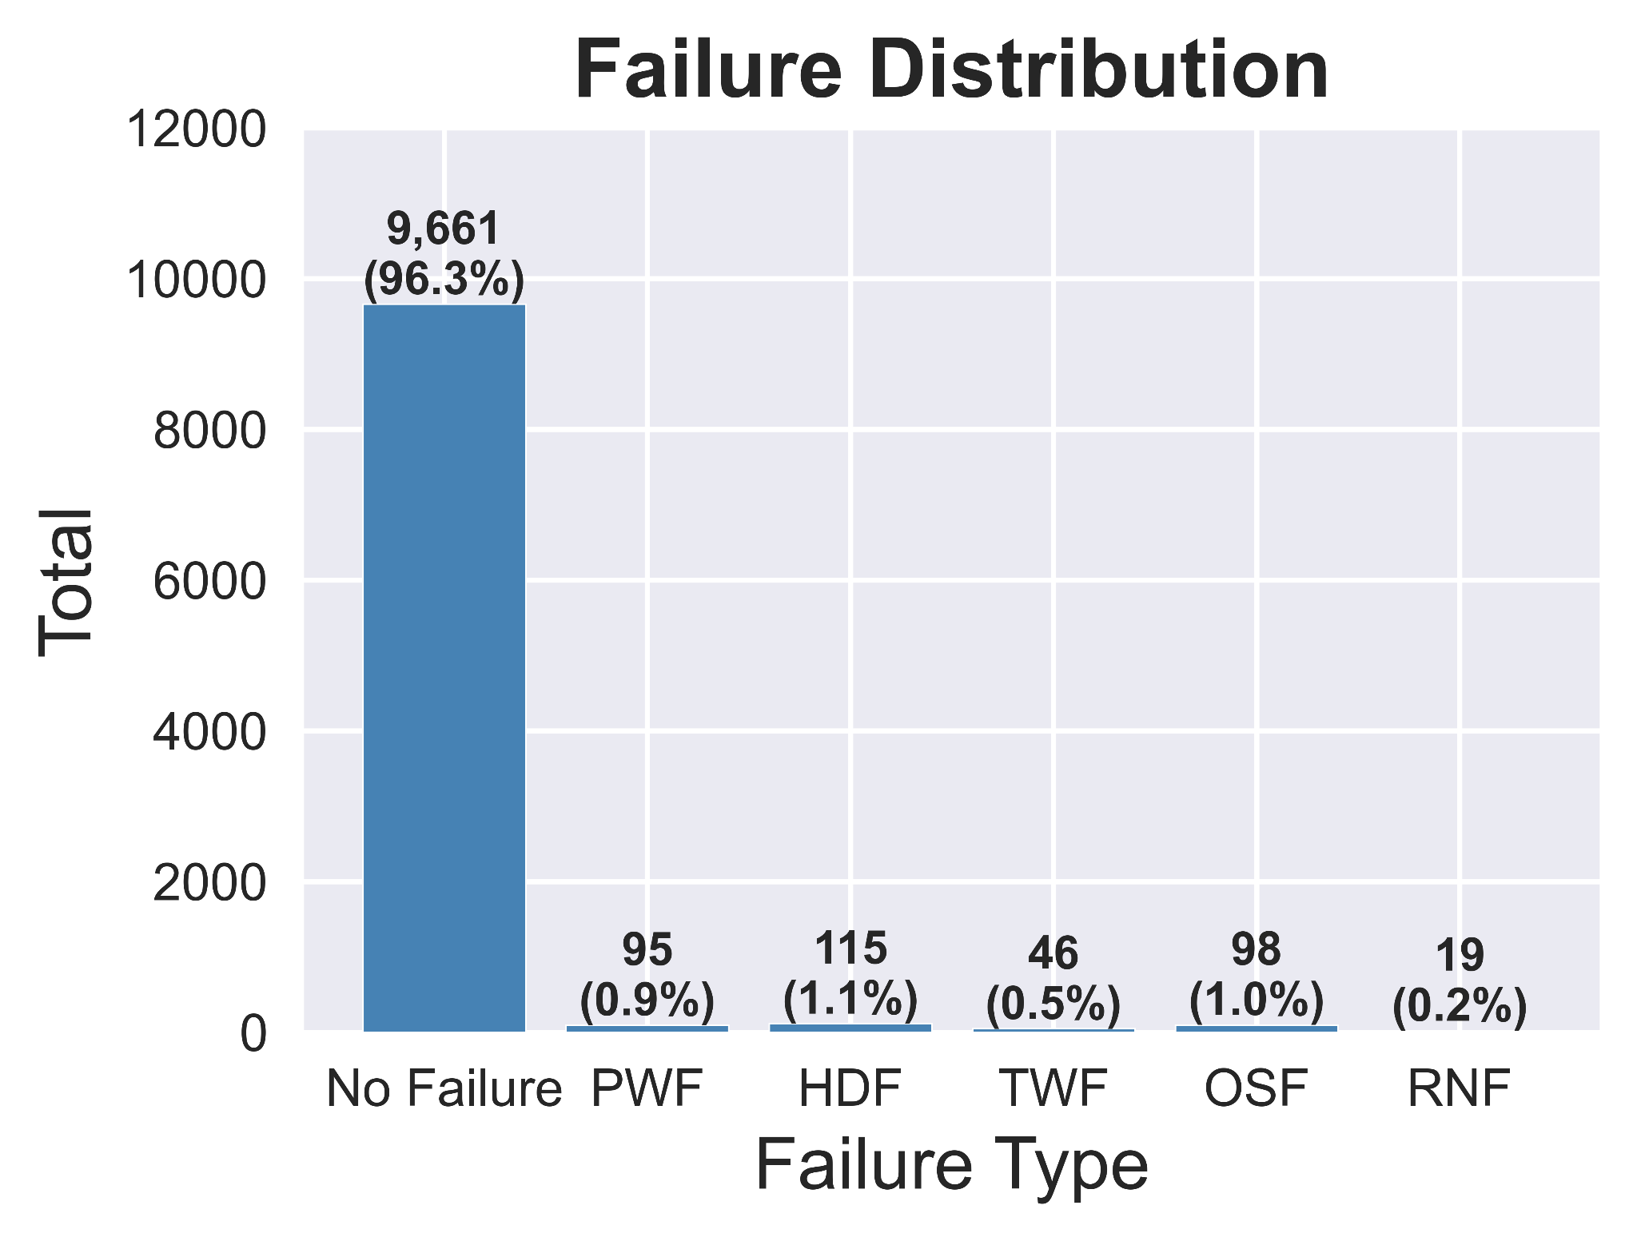
02 · Dataset Overview — AI4I 2020 (UCI)
10,000
Input Features
Failure Type Distribution
Samples
Air temperature [K]
6 predictors
Process temperature [K]
Features
Rotational speed [rpm]
5 failure types
Torque [Nm]
Target labels
Tool wear [min]
Failure Types:
Overstrain Failure (OSF)
Power Failure (PWF)
Heat Dissipation Failure (HDF)
Tool Wear Failure (TWF)
Random Failure (RNF)
≈ 1% per type
Product type (L / M / H)
Positive rate

Slide 5






03 · Methodology
Data
Ingestion
EDA &
Preprocessing
Imbalance
Handling
Hyperparameter
Tuning
Model
Training
Evaluation
▶
▶
▶
▶
▶
AI4I 2020
UCI
Scaling
Encoding
RandomOver-
Sampler
Optuna
Binary Testing:
Logistic Regression
Random Forests
XGBoost
Multilabel Testing:
Random Forests
XGBoost
AUC-PR
MCC · F1
Key Design Decisions
✓ Oversampling applied INSIDE each CV fold to prevent data leakage
✓ Optuna optimizes MCC as objective — robust to severe imbalance
✓ Stratified K-Fold (k=5) with multilabel compatible splitting
✓ Feature Engineering for model simplification

Slide 6
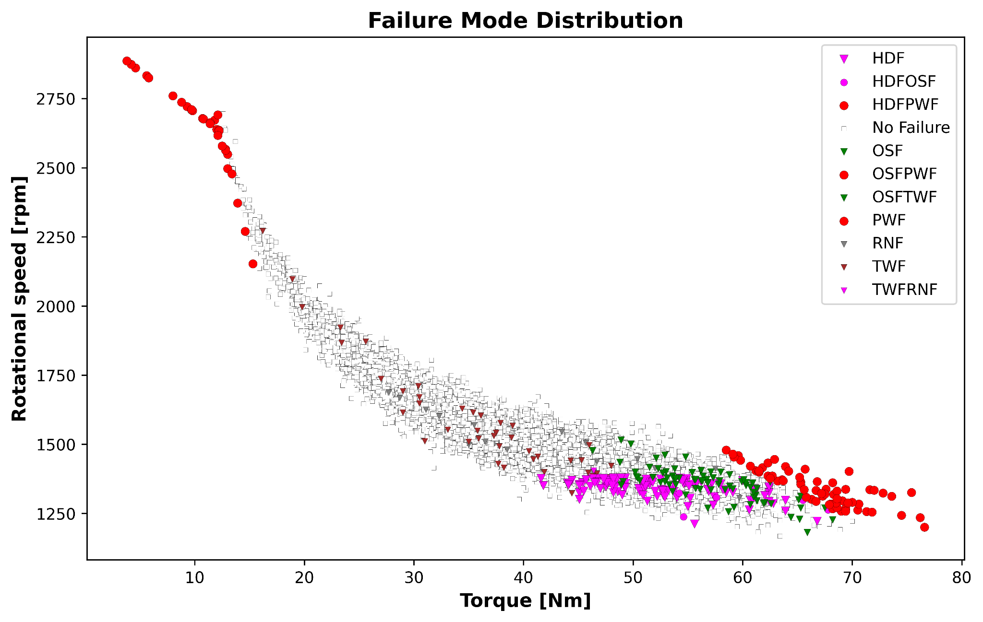
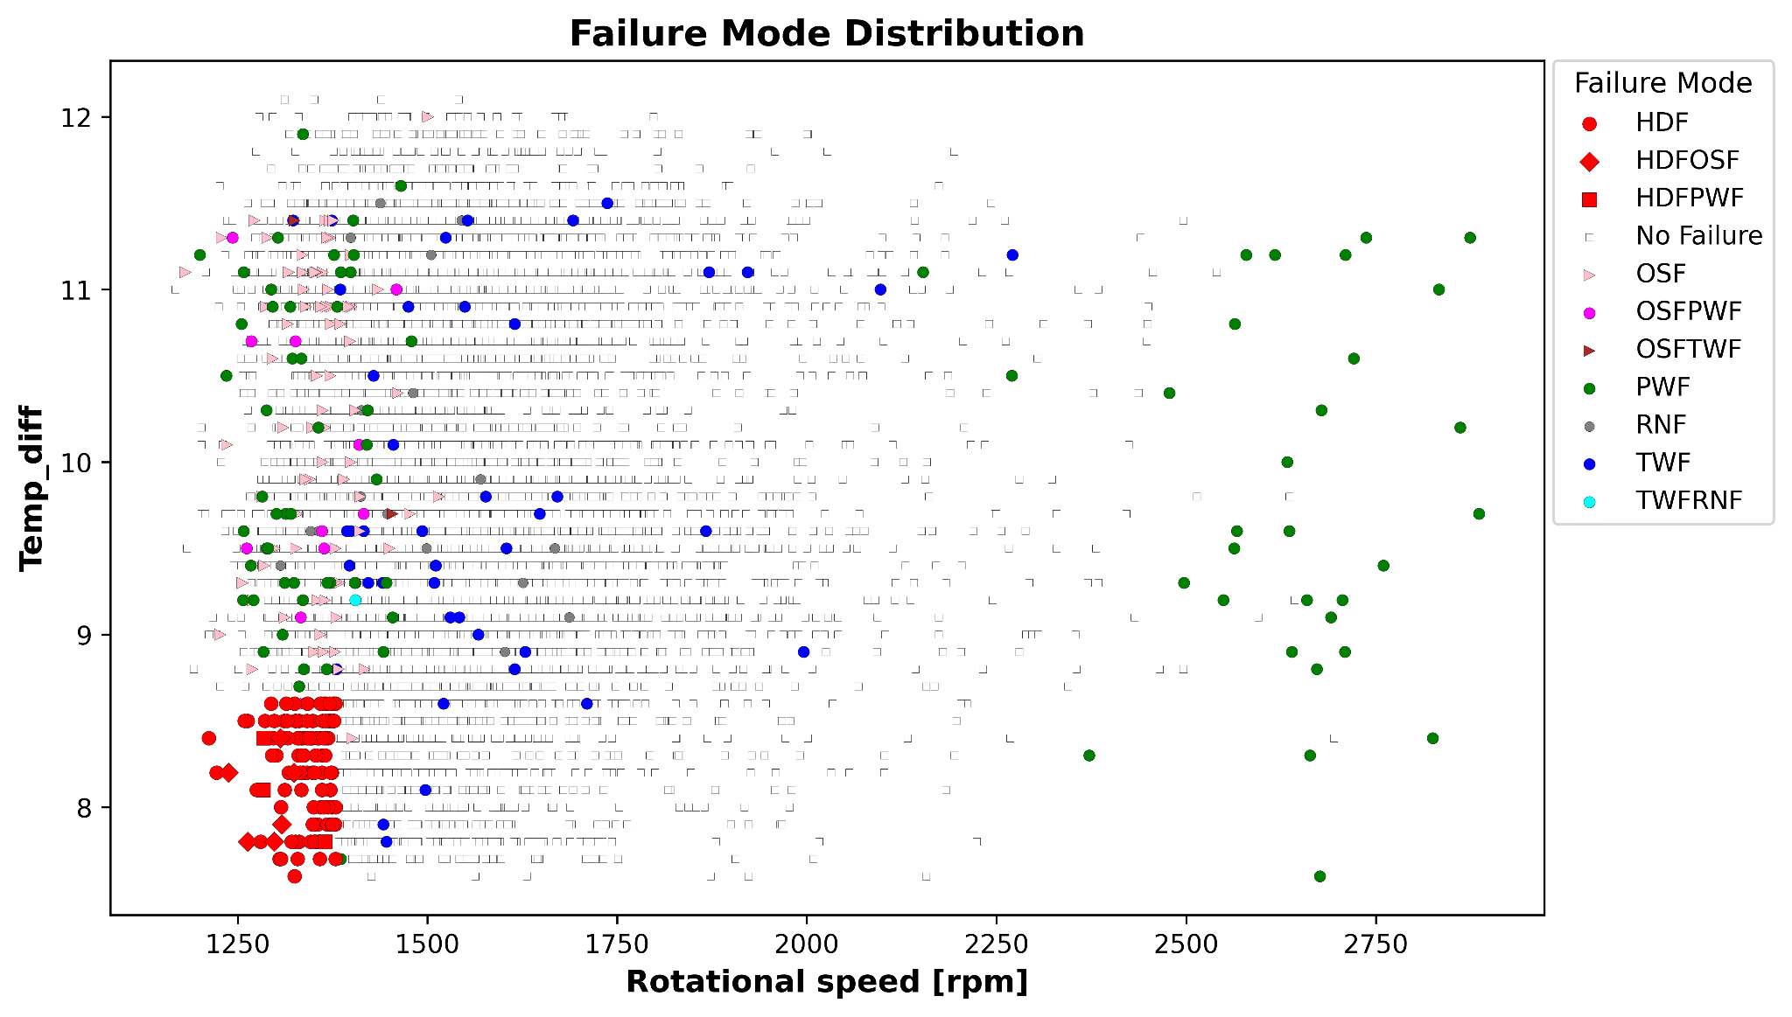
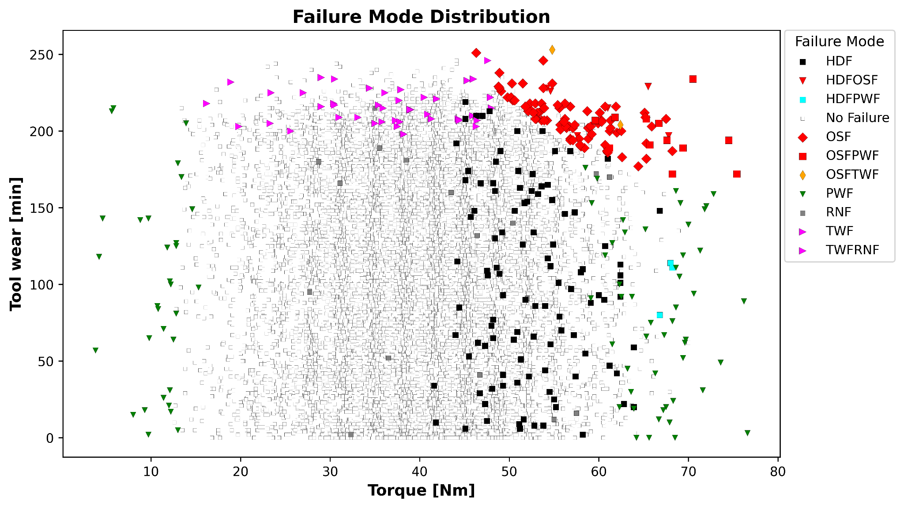
04 · Data Visualization - Preliminary Insights
Key Insights
Some Failure modes showed a clear pattern (OSF, PWF and HDF) in the preliminary analysis, indicating that our models were more likely to correctly predict them, while TWF and RNF patterns were not clearly seen through the plots made. That indeed reflected into poorer performance in predicting these kind of failures.

Slide 7
05 · Results & Model Comparison - Binary Model
🏆 Best Model (Binary): RFC_Reduced + Optuna · F1 = 0.851 · MCC (CV) = 0.796 · Precision = 0.864 · Recall = 0.838
57 Correct Failure Predictions out of 68 - 11 false negatives and 9 false positives
Key Metrics Summary
Model | MCC (CV) | F1
LR Baseline | 0.395 | 0.32
LR Optimized | 0.459 | 0.54
RFC Baseline | — | 0.78
RFC Reduced ★ | 0.796 | 0.851
XGBoost | — | 0.838

Slide 8
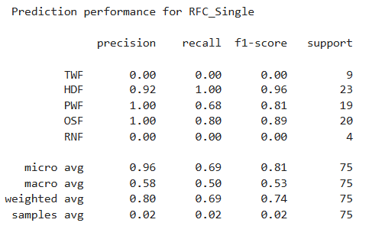

05 · Results & Model Comparison - Multilabel Model
🏆 Best Model (Binary): RFC_Single + Optuna · Total correct predictions: 52, out of 73. RNF and TWF are not predicted by our model. Considering only HDF, PWR and OSF → 52 out of 62 - 84% of correct predictions (only 2 FP)
Key Metrics Summary
Failure type | Detected failures | FN+FP
HDR | 23 | 0+2
OSF | 16 | 4+0
PWF | 13 | 6+0
TWF | 0 | 9+0
RNF | 0 | 4+0

Slide 9
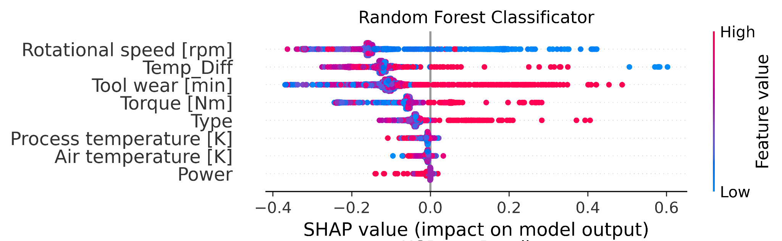
06 · Key Insights — SHAP Feature Importance
Rotational Speed #1 predictor
Torque & Tool Wear are key sensors as well
Engineered Temp_Diff matters
SHAP analysis on RFC_Reduced shows Rotational speed has the highest mean |SHAP| — Rotational speed category drives failure risk more than any sensor reading.
Tool wear 3rd, torque 4th. Together these three mechanical signals capture the bulk of failure risk.
The engineered feature Temp_Diff (process − air temp) outperforms the raw individual temperatures, confirming its predictive value for heat dissipation failures.

Slide 10


07 · Conclusions & Next Steps
RFC_Reduced + Optuna achieves F1 = 0.851 and MCC (CV) = 0.796 for binary machine failure, outperforming all baselines
57 correct predictions, 9 false positives and 11 false negatives → 74% of total machine downtime would be predictive
Multilabel RFC_Single correctly identifies 52 of 62 positive cases (2 FP, 10 FN) across 3 failure types on the test set
84% of Power Failures, Heat Dissipation Failures and Overstrain Failures would be held by predictive maintenance
Oversampling strictly within CV folds prevents data leakage — imblearn Pipeline ensures unbiased performance estimates
TWF and RNF remain hard to detect (recall 0%) — extremely rare events with fewer than 50 test samples require dedicated strategies
Next Steps
· LightGBM integration · Real-time inference pipeline · Deep learning baseline (LSTM)

Slide 11
APPENDIX
Technical Details · Hyperparameters · Extended Metrics · Cross-Validation

Slide 12
Appendix A · Optuna Hyperparameter Search Space - Binary Model
Logistic Regression
Random Forest
XGBoost
C (regularization)
1e-3 → 10
n_estimators
50 → 500
n_estimators
50 → 500
Penalty
l1, l2
max_depth
3 → 20
max_depth
3 → 10
Solver
liblinear, saga
min_samples_split
2 → 20
learning_rate
0.01 → 0.3
Max iter
100 → 500
max_features
sqrt, log2
subsample
0.5 → 1.0
colsample_bytree
0.5 → 1.0
scale_pos_weight
auto
Objective: maximize AUC-PR · 50 trials per model per label · Sampler: TPESampler · Pruner: MedianPruner

Slide 13
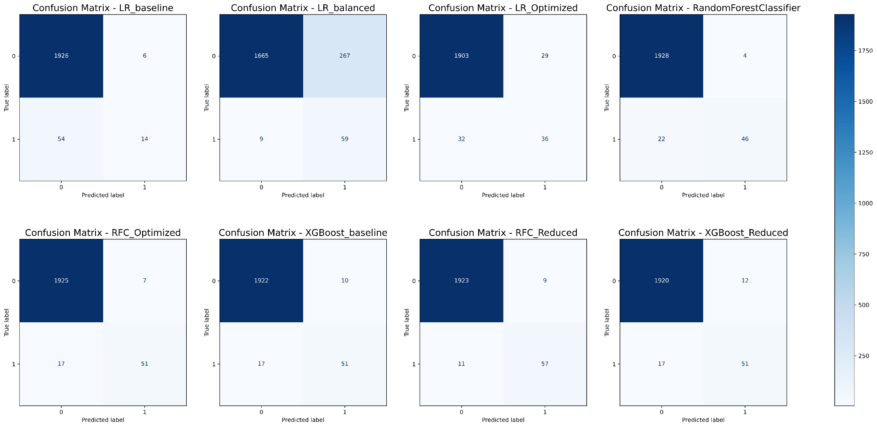
Appendix B · Per-Label Confusion Matrix Summary — RFC_Reduced
Test set results (20% split, 2000 samples). TWF & RNF have very few positive test cases (≤9), making recall 0% despite model detecting some in training. Multilabel Optuna best F1-micro = 0.8863.

Slide 14
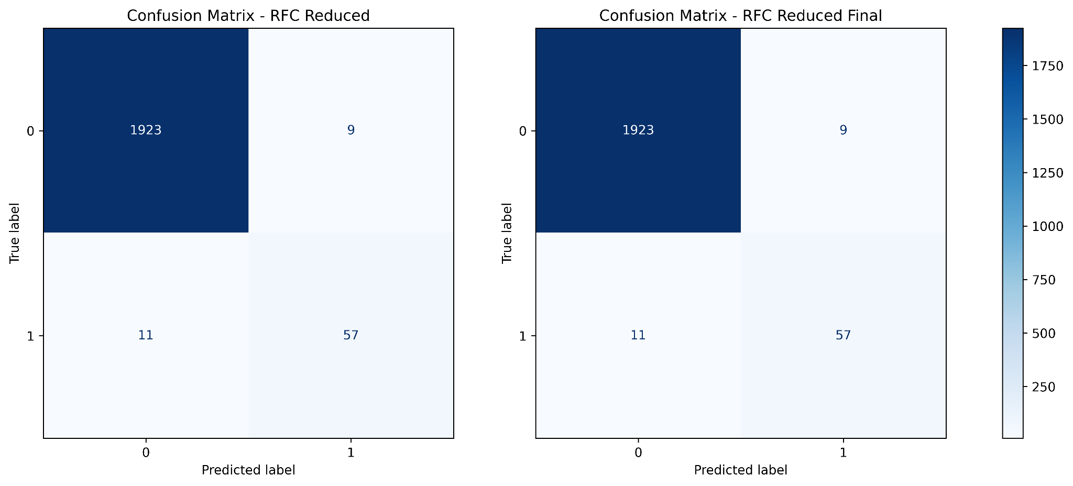
Appendix B · Per-Label Confusion Matrix Summary — RFC_Reduced
Test set results (20% split, 2000 samples). TWF & RNF have very few positive test cases (≤9), making recall 0% despite model detecting some in training. Multilabel Optuna best F1-micro = 0.8863.

Slide 15
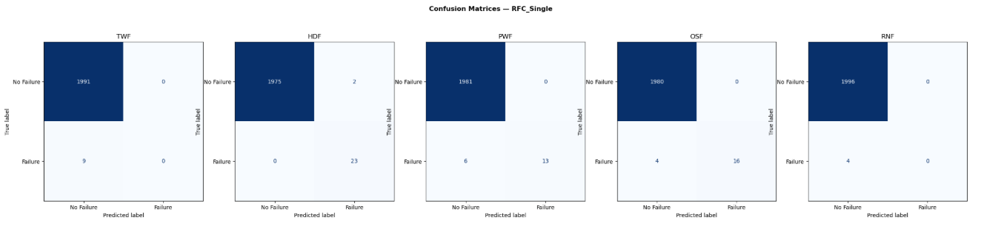
Appendix B · Per-Label Confusion Matrix Summary — RFC_Single (Multilabel)
Test set results (20% split, 2000 samples). TWF & RNF have very few positive test cases (≤9), making recall 0% despite model detecting some in training. Multilabel Optuna best F1-micro = 0.8863.

Slide 16
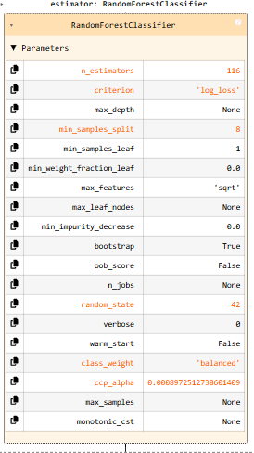
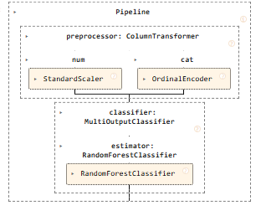
Appendix B · RFC_Single - Pipeline and parameters used post tuning
Test set results (20% split, 2000 samples). TWF & RNF have very few positive test cases (≤9), making recall 0% despite model detecting some in training. Multilabel Optuna best F1-micro = 0.8863.

Slide 17
Appendix C · Cross-Validation Strategy & Leakage Prevention
Stratified 5-Fold Cross-Validation with Oversampling Pipeline
Fold 1
Val
Train+OS
Train+OS
Train+OS
Train+OS
Why it matters
Applying oversampling before CV splits allows synthetic samples from the training set to appear in validation — inflating performance.
Fold 2
Train+OS
Val
Train+OS
Train+OS
Train+OS
Fold 3
Train+OS
Train+OS
Val
Train+OS
Train+OS
Fold 4
Train+OS
Train+OS
Train+OS
Val
Train+OS
Using imblearn Pipeline ensures the oversampler sees only each fold's training split, giving honest estimates.
Fold 5
Train+OS
Train+OS
Train+OS
Train+OS
Val
Training + Oversampling (inside fold)
Validation (original distribution)

